Slide 1
Normal Distribution
Eric Scott

Slide 2
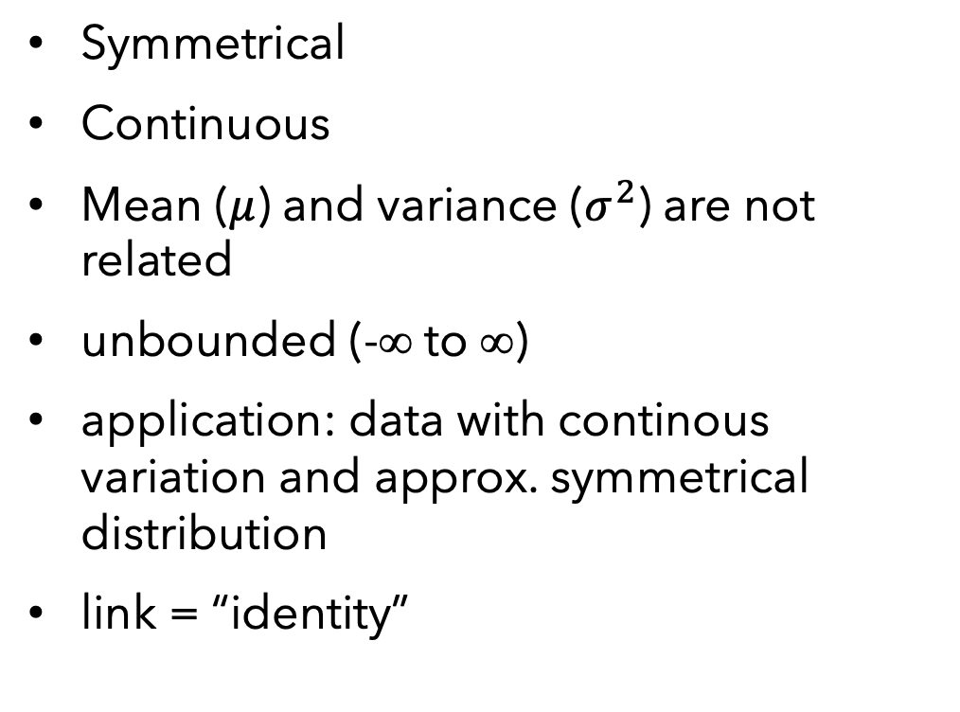
Normal (AKA Gaussian) Distribution
Symmetrical
Continuous
Mean ($μ$) and variance ($σ^{2}$) are not related
unbounded (-∞ to ∞)
application: data with continous variation and approx. symmetrical distribution
link = “identity”

Slide 3
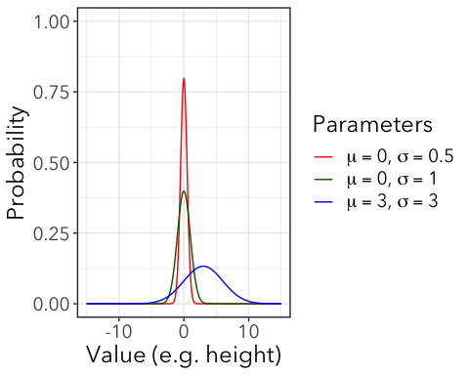
Normal Distributions
Defined by mean (µ) and standard deviation (σ)
Variance is not a function of the mean (less specific assumptions about generating processes)

Slide 4
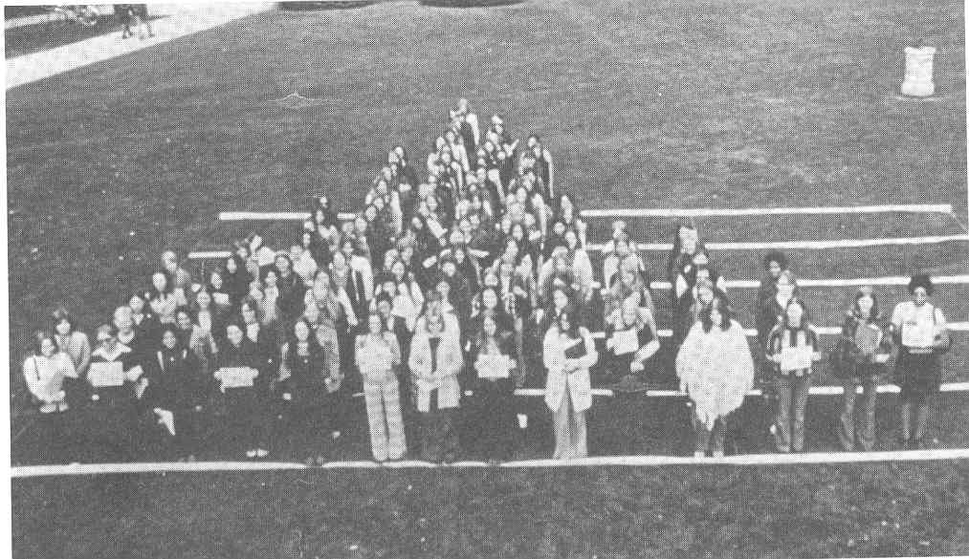
Few ecological variables are strictly Normal
but many approximately Normal
Figure 7.5 Females-only living histogram [From B. L. Joiner, 1975, “Living histograms” International Statistical Review 43:339-340
Notes:
Why only show females here? What would you expect if this had males on it as well???

Slide 5
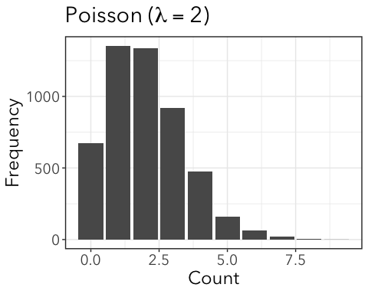
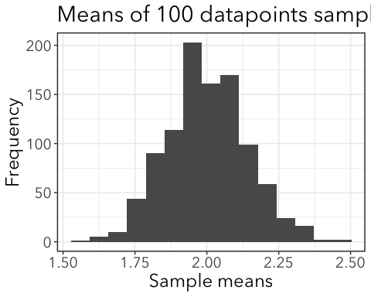
Why so common?
The sum or average of a large number of samples from any distribution will be normally distributed, even if the starting distribution is extremely skewed (not symmetrical)
Means of 100 datapoints sampled from Poisson

Slide 6
Why so common?
The sum or average of a large number of samples from any distribution will be normally distributed
Many biological quantities are controlled by multiple additive factors.
E.g. polygenic traits—many genes (and parts of the environment) control height in humans. Added together, height is continuous.

Slide 7
Why so common?
The product of a large number of samples from any positive (>0) distribution will be log-normally distributed.

Slide 8
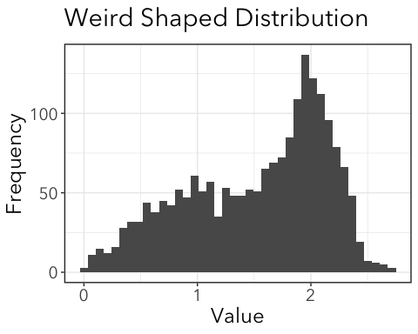
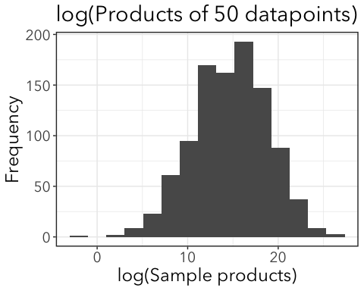
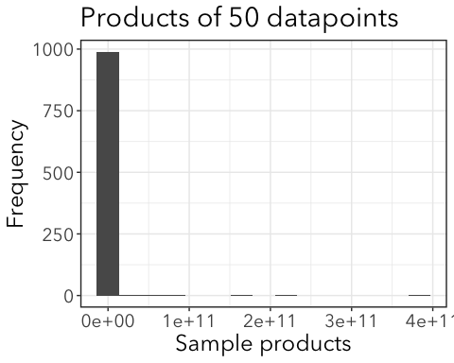
Why so common?
The product of a large number of samples from any positive (>0) distribution will be log-normally distributed.
Notes:
log or exp????

Slide 9
Why so common?
The product of a large number of samples from any positive (>0) distribution will be log-normally distributed.
Skewed distributions common when mean values are low, variances large, and values cannot be negative.

Slide 10
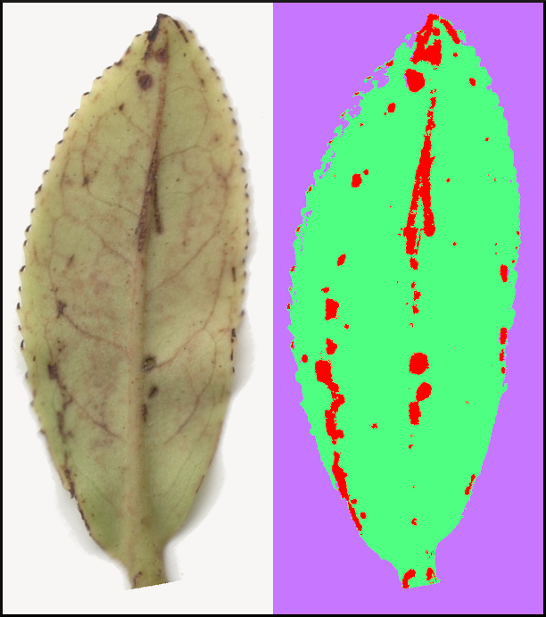
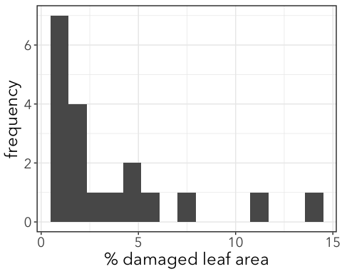
Example: Leaf damage

Slide 11
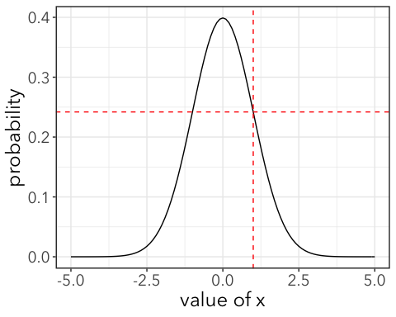
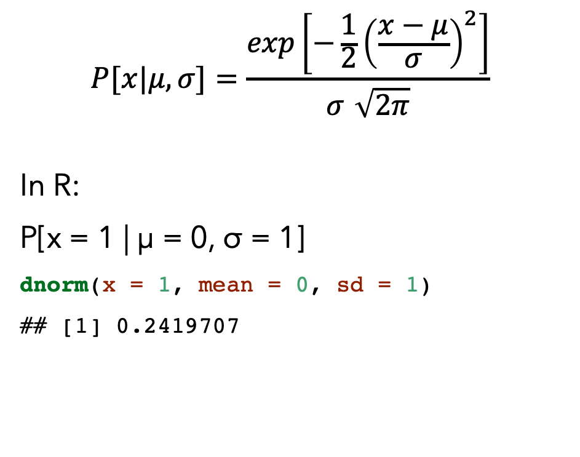
Probability density function (PDF)
$$P[x|μ,σ]=\frac{exp\left[−\frac{1}{2}{\left(\frac{x−μ}{σ}\right)}^{2}\right]}{σ\sqrt{2π}}$$
In R:
P[x = 1 | µ = 0, σ = 1]
dnorm(x = 1, mean = 0, sd = 1)
## [1] 0.2419707
Any value is possible, but some are highly unlikely.
Notes:
* You do not need to know how to use this equation. Note: the probability of getting any specific number (e.g 1) from a continuous distribution is technically zero!

Slide 12
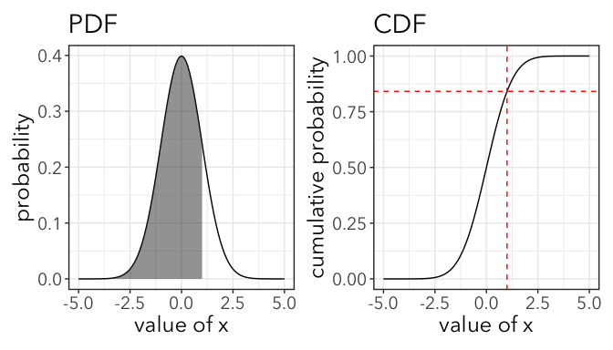
Cumulative Density Function (CDF)
CDF is the area under the normal curve.
So if we want to know P[x ≤ 1], we can use the CDF.
in R:
P[x ≤ 1 | µ = 0, σ = 1] =
pnorm(1, mean = 0, sd = 1, lower.tail = TRUE)
## [1] 0.8413447
84% of PDF is below x = 1

Slide 13
CDF is the area under the curve of the PDF
84% of PDF is below x = 1

Slide 14
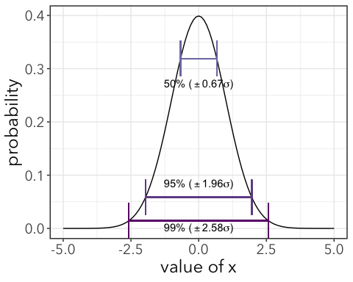
50% of PDF is within µ ± 0.67σ
95% of PDF is within µ ± 1.96σ
99% of PDF is within µ ± 2.58σ

Slide 15
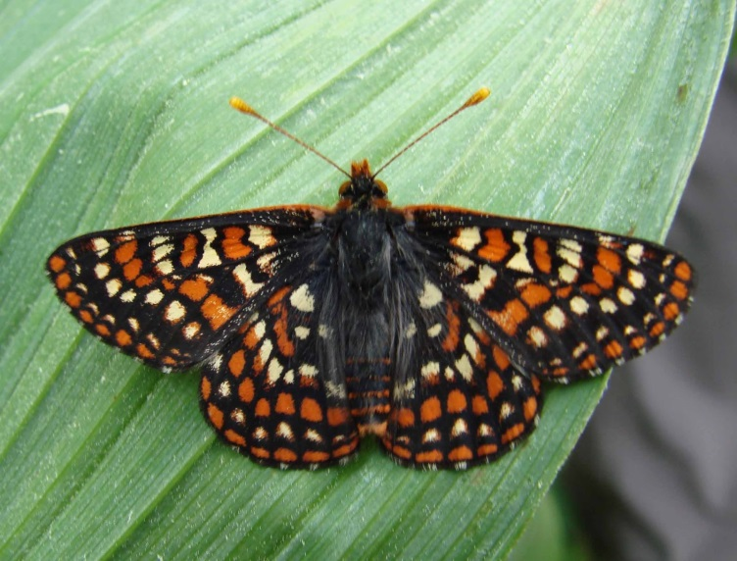
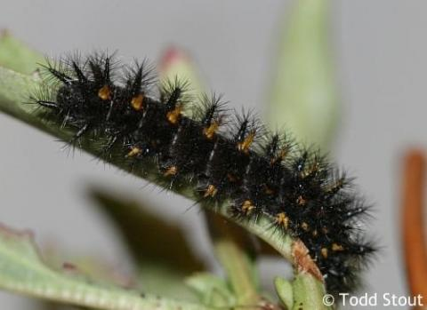
Example: Effects of herbicide on Checkerspot caterpillar growth

Slide 16
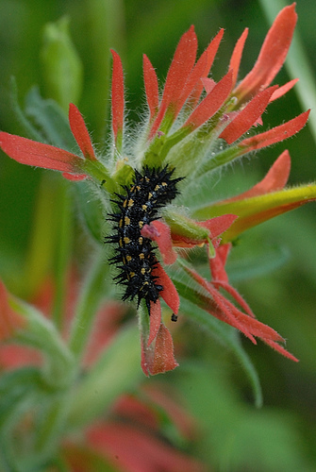
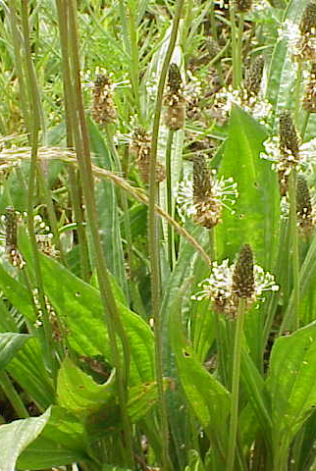
Experimental design:
Caterpillars reared on
2 host plants
x
plants sprayed or not with herbicide
= 4 treatment groups
Castilleja sp. (Paintbrush)
Plantago lanceolata (English plantain)
Notes:
Write these out on board

Slide 17
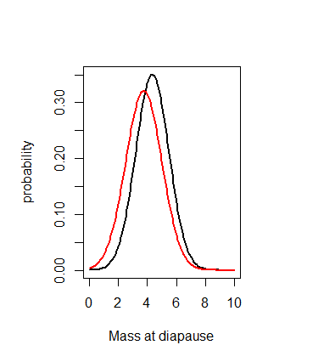
Herbicide None
Paintbrush
English plantain
Notes:
Slightly different herbicide vs none, but are they significantly different????

Slide 18
Example: Effects of herbicide on caterpillar growth
cats <- read_csv(here("data", "HerbicideCaterpillars.csv")) %>% janitor::clean_names() head(cats)
## # A tibble: 6 x 4 ## species host treat mass ## <chr> <chr> <chr> <dbl> ## 1 TCB Castilleja Control 4.53 ## 2 TCB Castilleja Control 3.67 ## 3 TCB Castilleja Control 5.84 ## 4 TCB Castilleja Control 2 ## 5 TCB Castilleja Control 4.25 ## 6 TCB Castilleja Control 5.44

Slide 19
Model Selection:
Select probability distribution
From 1st principles
Analysis of data
Select factors that determine the expected value
AIC analysis of competing models
LRT of nested models
“marginal” hypothesis tests
OR
OR
Notes:
Here we’ll go over examples of ”marginal” hypothesis tests

Slide 20
2a. Competing models with AIC
Model | df | AIC
0. All have same mass
1. Herbicide affects average mass
2. Host plants affect average mass
3. Host plant + Herbicide effects
4. Herbicide effects that differ among hosts

Slide 21
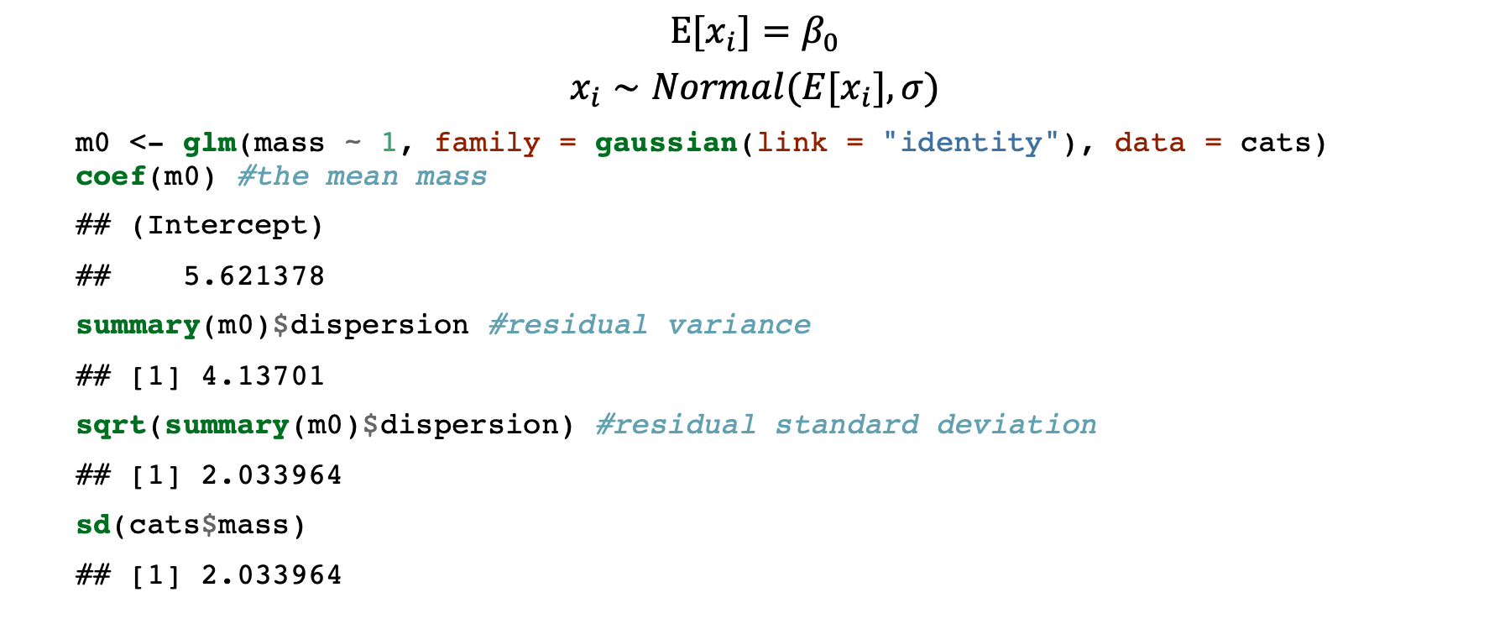
0. All have the same mass
$$E[x_{i}]=β_{0}$$
$$x_{i}∼Normal(E[x_{i}],σ)$$
m0 <- glm(mass ~ 1, family = gaussian(link = "identity"), data = cats) coef(m0) #the mean mass
## (Intercept) ## 5.621378
summary(m0)$dispersion #residual variance
## [1] 4.13701
sqrt(summary(m0)$dispersion) #residual standard deviation
## [1] 2.033964
sd(cats$mass)
## [1] 2.033964

Slide 22
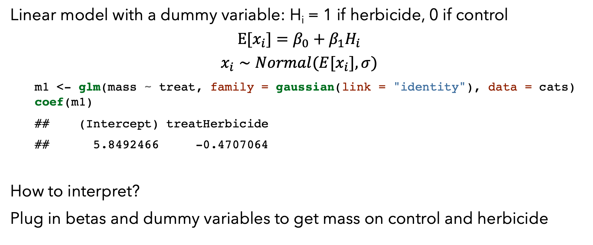
1. Effect of herbicide
Linear model with a dummy variable: H_{i} = 1 if herbicide, 0 if control
$$E[x_{i}]=β_{0}+β_{1}H_{i}$$
$$x_{i}∼Normal(E[x_{i}],σ)$$
m1 <- glm(mass ~ treat, family = gaussian(link = "identity"), data = cats) coef(m1)
## (Intercept) treatHerbicide ## 5.8492466 -0.4707064
How to interpret?
Plug in betas and dummy variables to get mass on control and herbicide

Slide 23
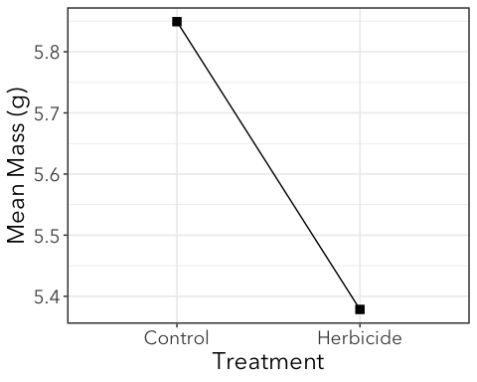
1. Effect of herbicide plot

Slide 24
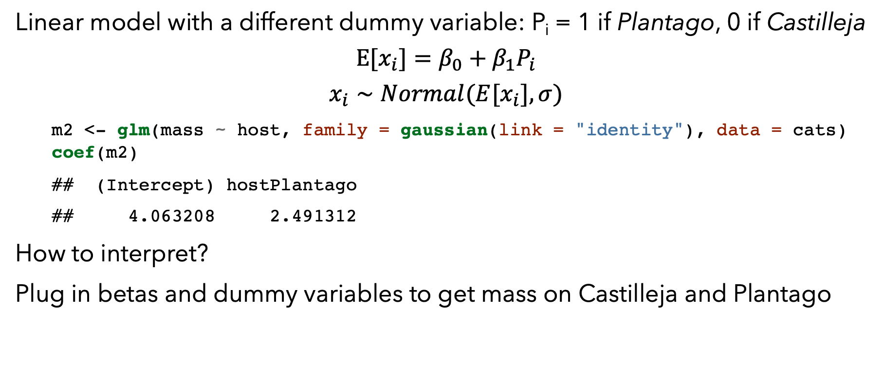
2. Effect of host plant
Linear model with a different dummy variable: P_{i} = 1 if Plantago, 0 if Castilleja
$$E[x_{i}]=β_{0}+β_{1}P_{i}$$
$$x_{i}∼Normal(E[x_{i}],σ)$$
m2 <- glm(mass ~ host, family = gaussian(link = "identity"), data = cats) coef(m2)
## (Intercept) hostPlantago ## 4.063208 2.491312
How to interpret?
Plug in betas and dummy variables to get mass on Castilleja and Plantago

Slide 25
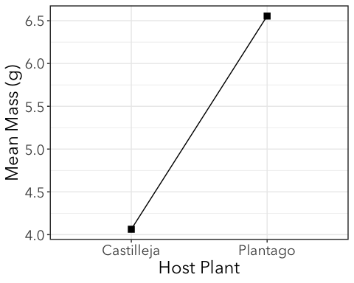
2. Effect of host plant

Slide 26
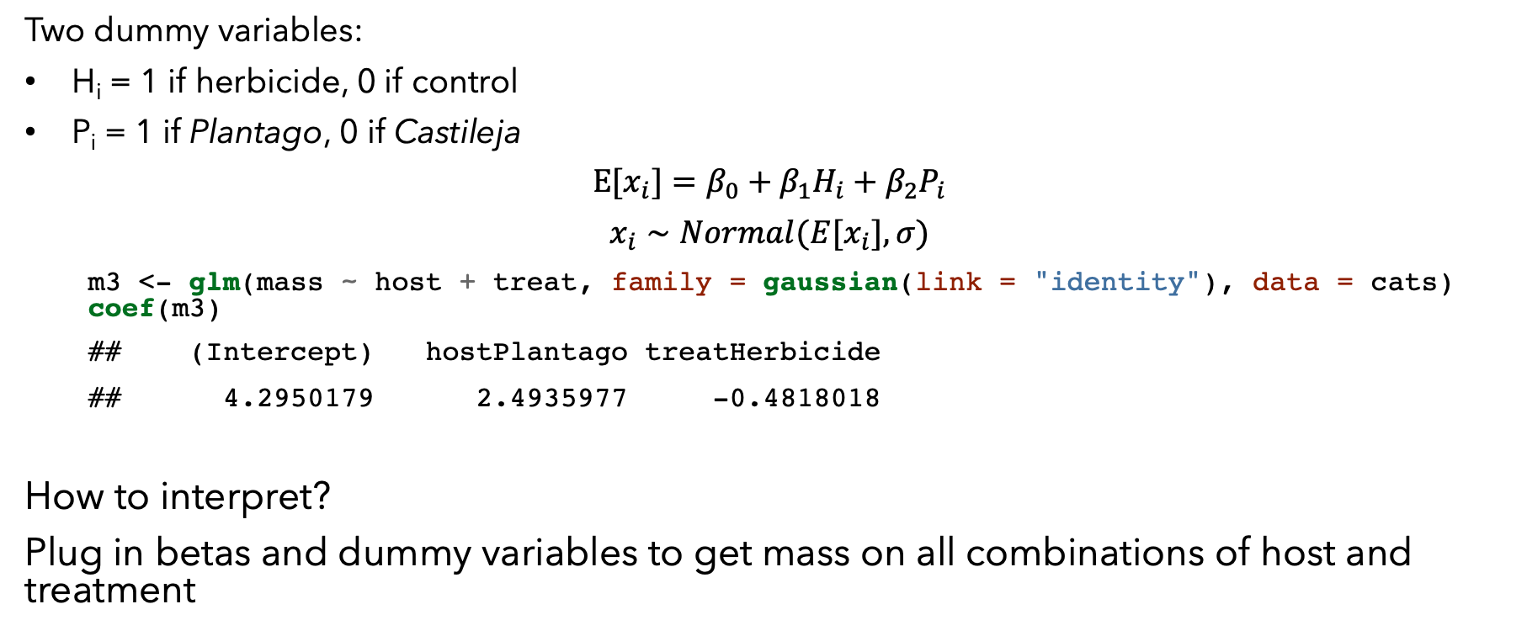
3. Effects of both herbicide and host
Two dummy variables:
H_{i} = 1 if herbicide, 0 if control
P_{i} = 1 if Plantago, 0 if Castileja
$$E[x_{i}]=β_{0}+β_{1}H_{i}+β_{2}P_{i}$$
$$x_{i}∼Normal(E[x_{i}],σ)$$
m3 <- glm(mass ~ host + treat, family = gaussian(link = "identity"), data = cats) coef(m3)
## (Intercept) hostPlantago treatHerbicide ## 4.2950179 2.4935977 -0.4818018
How to interpret?
Plug in betas and dummy variables to get mass on all combinations of host and treatment

Slide 27
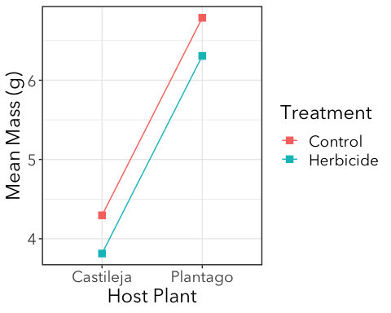
3. Effect of host and treatment

Slide 28
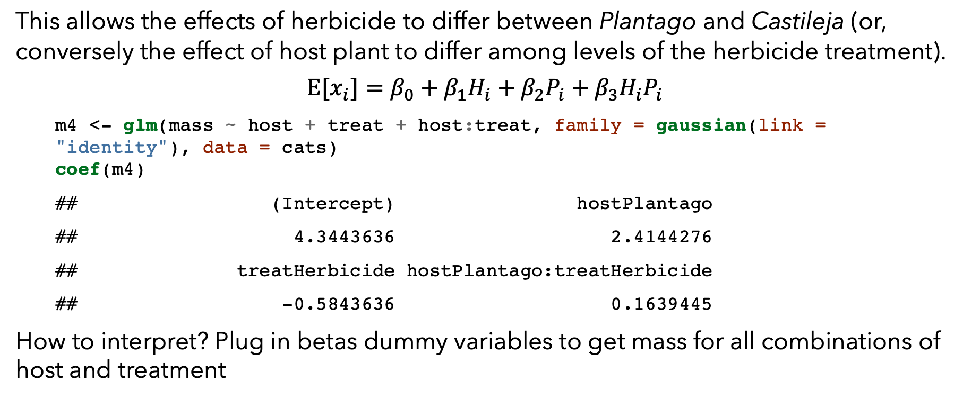
4. Interaction between host plant and treatment
This allows the effects of herbicide to differ between Plantago and Castileja (or, conversely the effect of host plant to differ among levels of the herbicide treatment).
$$E[x_{i}]=β_{0}+β_{1}H_{i}+β_{2}P_{i}+β_{3}H_{i}P_{i}$$
m4 <- glm(mass ~ host + treat + host:treat, family = gaussian(link = "identity"), data = cats) coef(m4)
## (Intercept) hostPlantago ## 4.3443636 2.4144276 ## treatHerbicide hostPlantago:treatHerbicide ## -0.5843636 0.1639445
How to interpret? Plug in betas dummy variables to get mass for all combinations of host and treatment

Slide 29
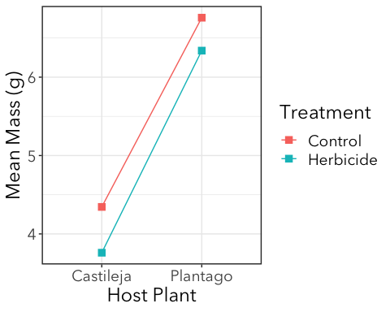
4. Interaction
Slopes differ slightly

Slide 30
Model competition with AIC
AIC(m0, m1, m2, m3, m4)
## df AIC ## m0 2 1207.970 ## m1 3 1206.145 ## m2 3 1086.878 ## m3 4 1082.661 ## m4 5 1084.491
RESULTS:
“The best model for the data included host plant and herbicide treatment as predictors, but not their interaction (model with interaction: dAIC = 1.8). Herbicide treatment reduced mean caterpillar mass at diapause in both hosts and caterpillars raised on Castilleja had lower mean mass in both control and herbicide treatments.”

Slide 31
Marginal Hypothesis Test
Sort of a ”shortcut” to testing nested hypotheses with LRT
BUT, doesn’t actually do sequential testing. (e.g. remove one factor at a time).
Marginal hypothesis testing tests the effects of one predictor over all the levels of other predictors.
Related to Analysis of Variance (ANOVA).
The GLM in m4 is a 2-way ANOVA!

Slide 32
Marginal Hypothesis Test
library(car)
Anova(m4)
## Analysis of Deviance Table (Type II tests) ## ## Response: mass ## LR Chisq Df Pr(>Chisq) ## host 155.777 1 < 2e-16 *** ## treat 6.200 1 0.01278 * ## host:treat 0.168 1 0.68177 ## --- ## Signif. codes: 0 '***' 0.001 '**' 0.01 '*' 0.05 '.' 0.1 ' ' 1
RESULTS:
“There was a significant effect of host plant (p < 0.001) and treatment (p = 0.0128), but not their interaction (p = 0.682) on caterpillar mass at diapause. Herbicide treatment reduced mean …”

Slide 33
Marginal Hypothesis Test
library(car)
Anova(m4)
## Analysis of Deviance Table (Type II tests) ## ## Response: mass ## LR Chisq Df Pr(>Chisq) ## host 155.777 1 < 2e-16 *** ## treat 6.200 1 0.01278 * ## host:treat 0.168 1 0.68177 ## --- ## Signif. codes: 0 '***' 0.001 '**' 0.01 '*' 0.05 '.' 0.1 ' ' 1
Things to know:
These are the p-values you’re looking for!
Do not trust the p-values from anova() (lowercase “a”)!
It does sequential testing, which is not the same as marginal testing, and isn’t appropriate in some cases.
car::Anova() (capital “A”) will almost always do the correct thing.

Slide 34
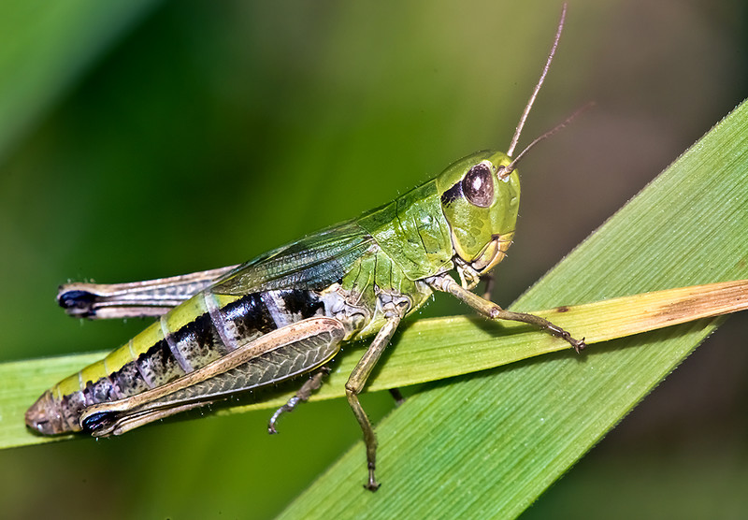
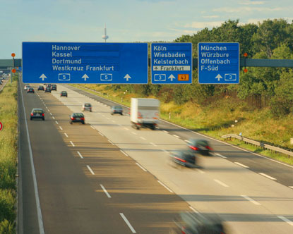

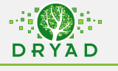
Bow-winged grasshoppers: (Chorthippus biguttulus)
Does road noise affect grasshopper song?
Factorial experiment:
2 source populations: near and far from roads
2 rearing environments: noisy and quiet
How does noise affect the pitch at which grasshoppers “sing”?

